Slide 1


Online store
Management
system
Time 2024/05/25

Slide 2




Group 6
product service
Nguyen Ngoc Duy
Thai Duy Tung
Tran Thanh Tin
Tran Hong Phong
Scrum Master .
member
member
member

Slide 3


CONTENT
1
Product introduction
2
Function
3
Activity diagram
4
Demo

Slide 4
PART 01
Product introduction

Slide 5
Product introduction
-Research existing management systems on the market.
-Analyze the needs and requirements of businesses.
-Competitive assessment and technology trends.
- Collect information from customers and users.
-Evaluate the value and effectiveness of solutions.

Slide 6
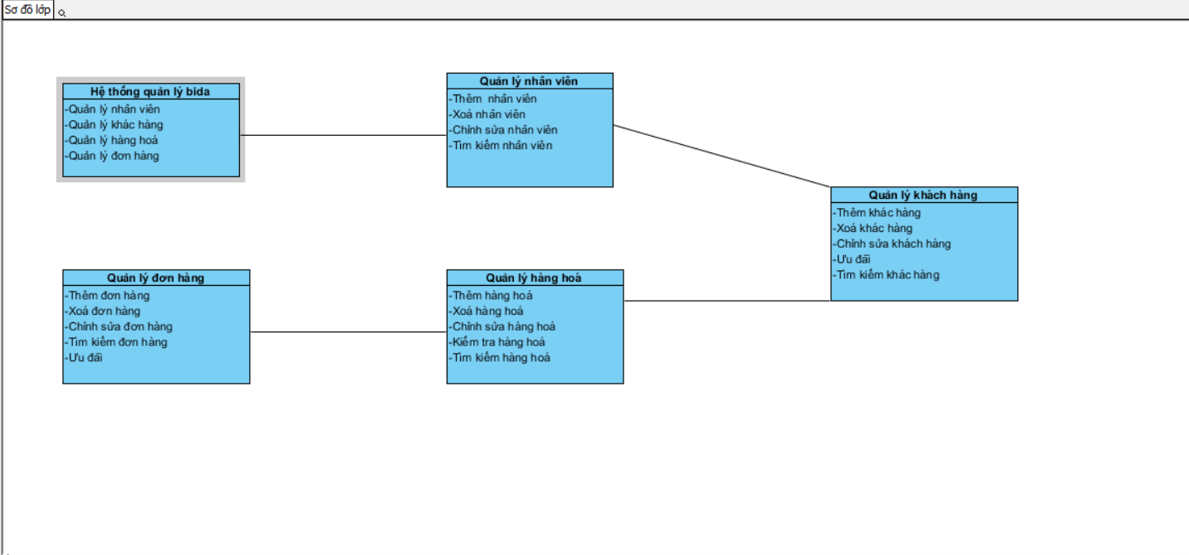
2.Function

Slide 7
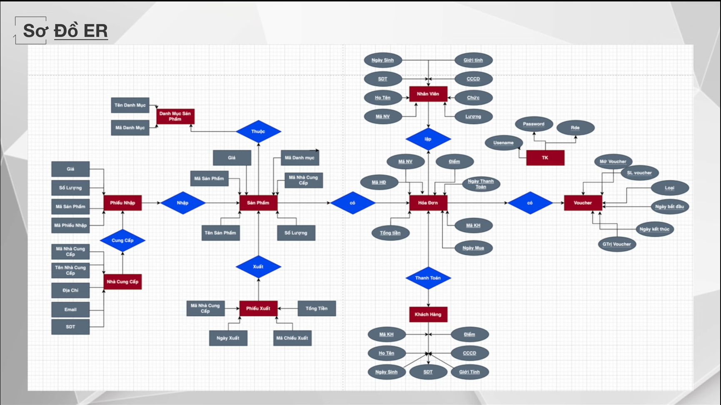
2.Function

Slide 8
3.activity diagram

Slide 9
2024
THANKS

